Slide 1
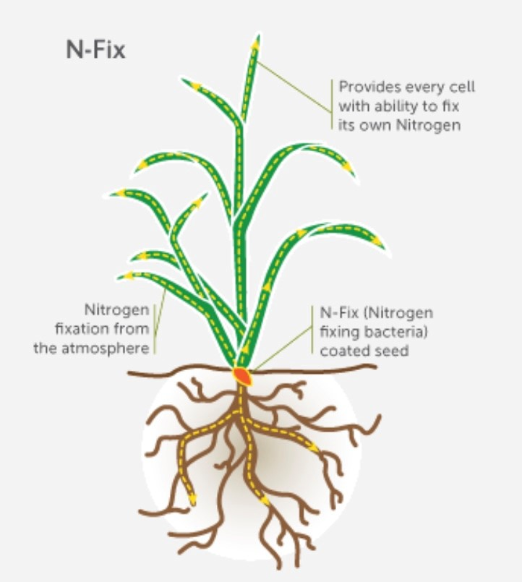
UK - Azotic Technologies
Gluconacetobacter diazotrophicus
Isolated from sugarcane
Symbiotic N-fixing bacterium that can colonize a wide range of non-leguminous plants
Wheat, barley, rice, maize
Endophytic in root and shoot

Slide 2
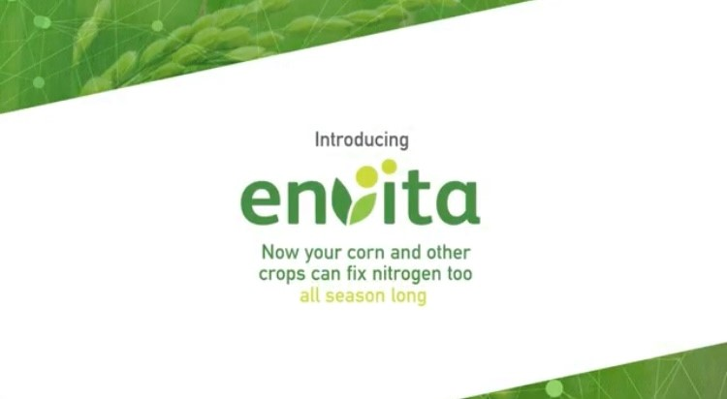
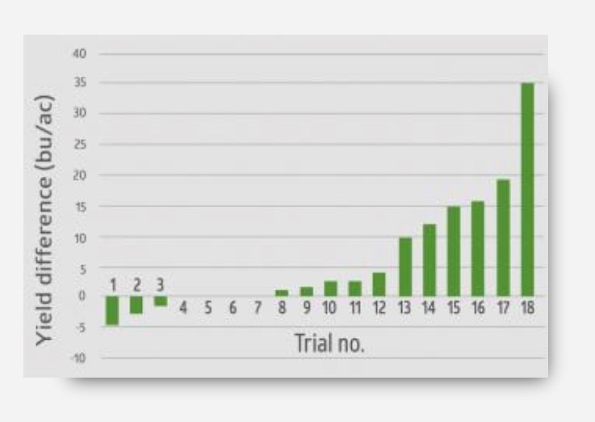
Registered in the US – corn, soybean
In-furrow and foliar applications
Up to 20% yield increase (10 bu/ac)
US Corn trial
Replaces up to 50% of the plant’s nitrogen needs

Slide 3
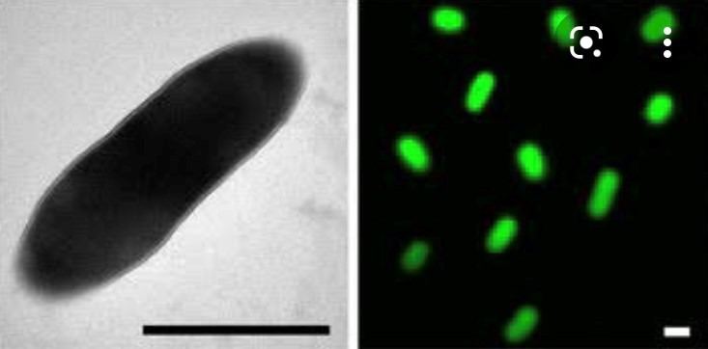
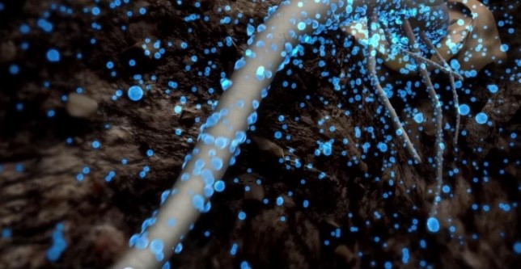
Pivot Bio – ProveN®
Klebsiella variicola 137

Slide 4
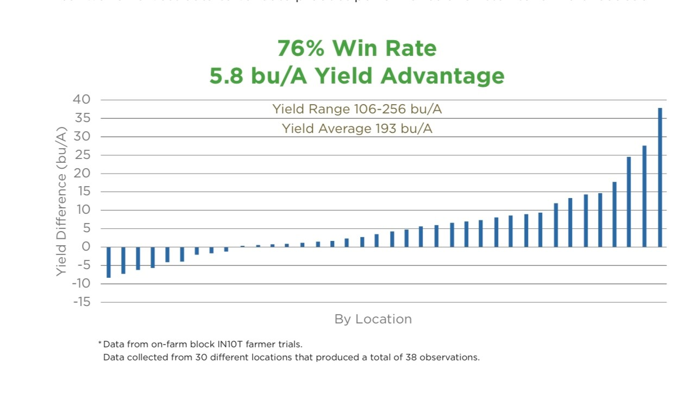
Corn, Wheat, Barley, Rye, Rice
Applied in-furrow at planting
Produces 25 lbs N (40 lbs synth N)
Costs - $20 per acre ($100 per acre synth N)

Slide 5
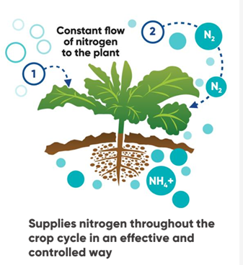
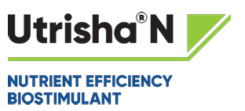
Corteva - Utrisha®N
Methylobacterium symbioticum
Cereals, Oilseed Rape, Maize

Slide 6
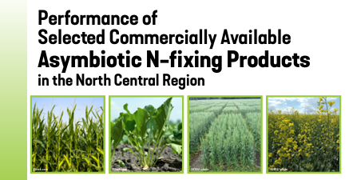
Sounds too good to be true
All are considered new organisms to NZ – so import/regulatory hurdles
Some use a GE process during production
Independent evaluation by US land-grant Universities (65 trials across 5 states)
Limited yield benefits from using these products

Slide 7
NZ research and development
FAR contracted Lincoln Agritech to isolate N-fixing bacteria from NZ arable soils/crops
Approx. 200 isolates from barley/wheat/maize/grass
Screened in lab and glasshouse trials on barley, maize and wheat.
Some promising results
50% N application plus inoculant = 100% N control

Slide 8
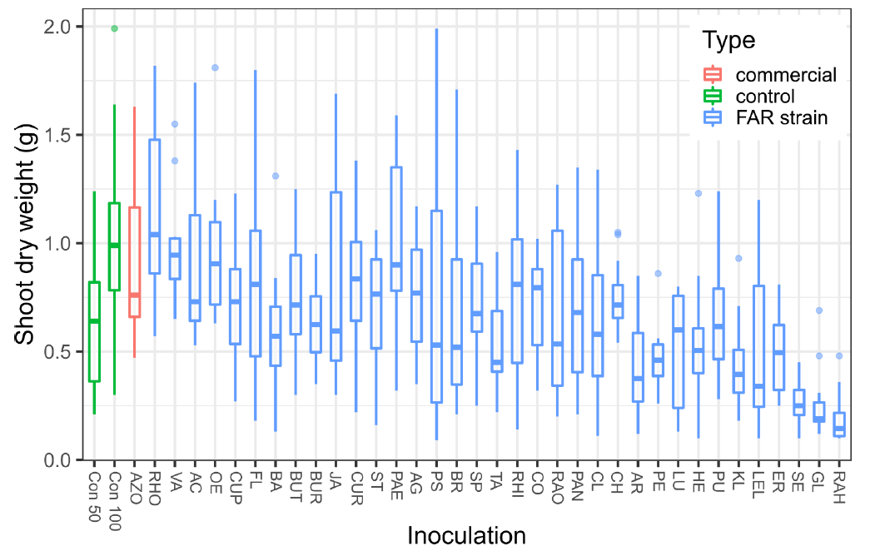
Barley trial
Plant height
No of Tillers
Root and shoot DW
Chlorophyll content
Seed count
Seed DW
100% N control
50% N
Trt 1
50% N Trt 2
50% N Trt 3
50% N control
100% N control
50% N + treatment

Slide 9
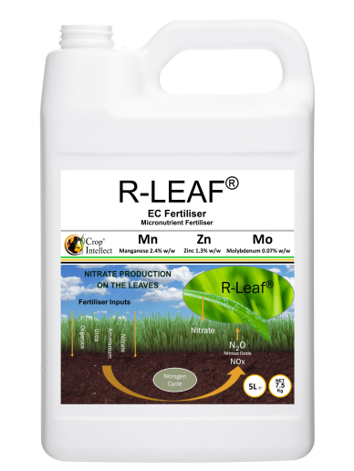
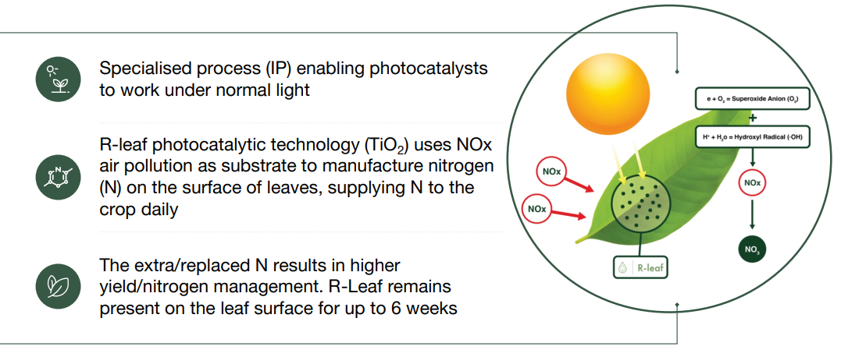
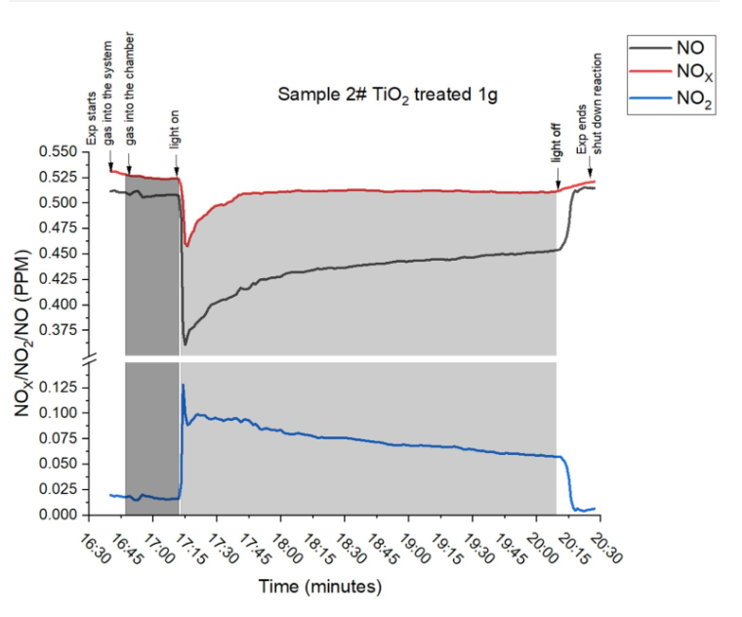
New Innovation - R-Leaf Fertiliser

Slide 10
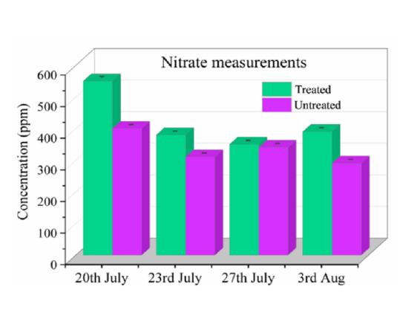
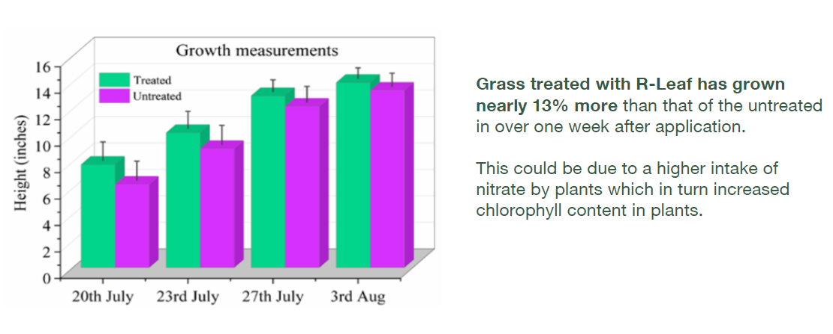
Pasture grass trials

Slide 11
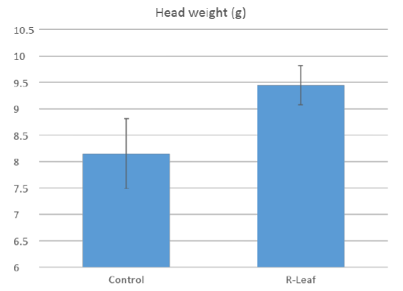
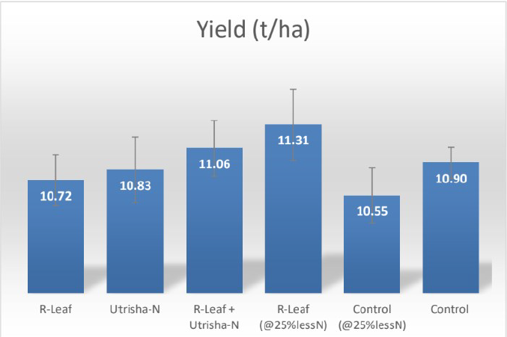
Cereal trials

Slide 12
Clean Ammonia
Current manufacture of ammonia is via the Haber-Bosch chemical pathway
Very emissions intensive
University of Cambridge (NIUM spin out company)
New way of producing ammonia

Slide 13
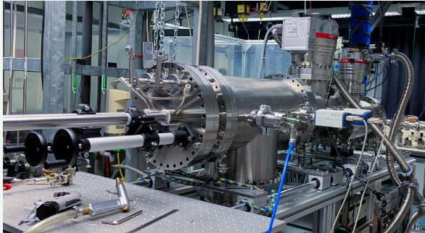
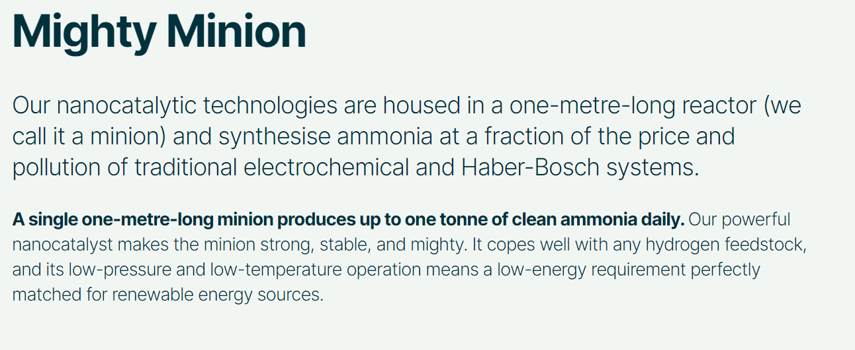
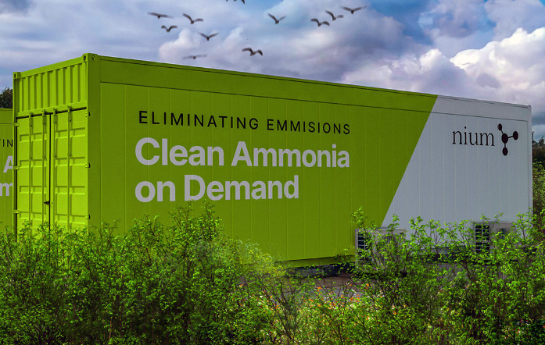
Clean Ammonia

Slide 14
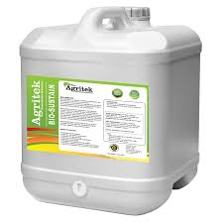
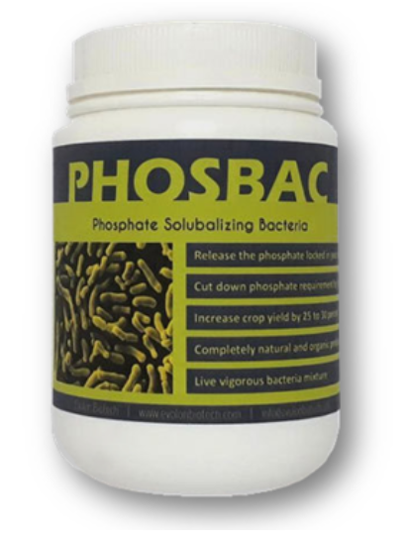
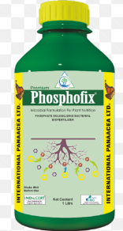
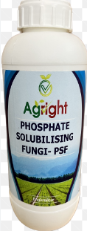
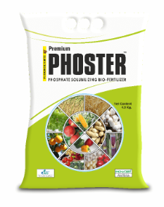
Phosphate solubilization
Phosphorus – limiting nutrient in the soil
Not in a plant available form
Some soil microbes (bacteria and fungi) can solubilize the phosphate and make it more readily taken up by plants
Range of commercial inoculants in the market

Slide 15
Ultraviolet Light Technology

Slide 16
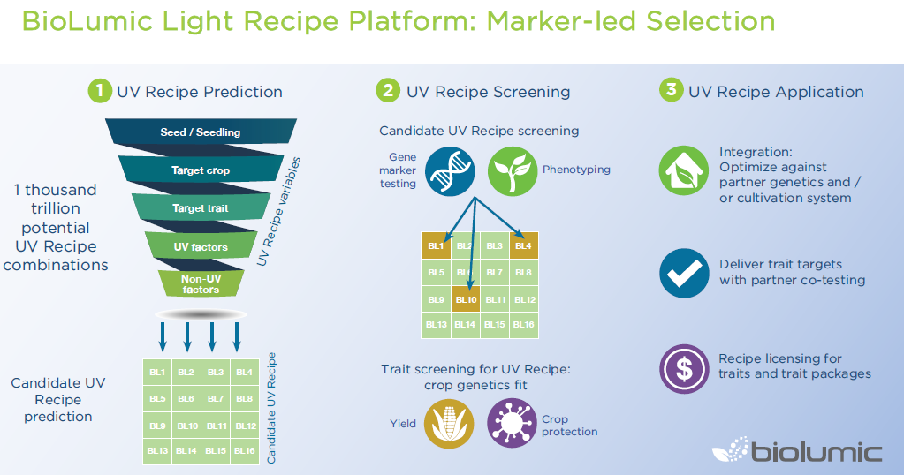
Biolumic

Slide 18
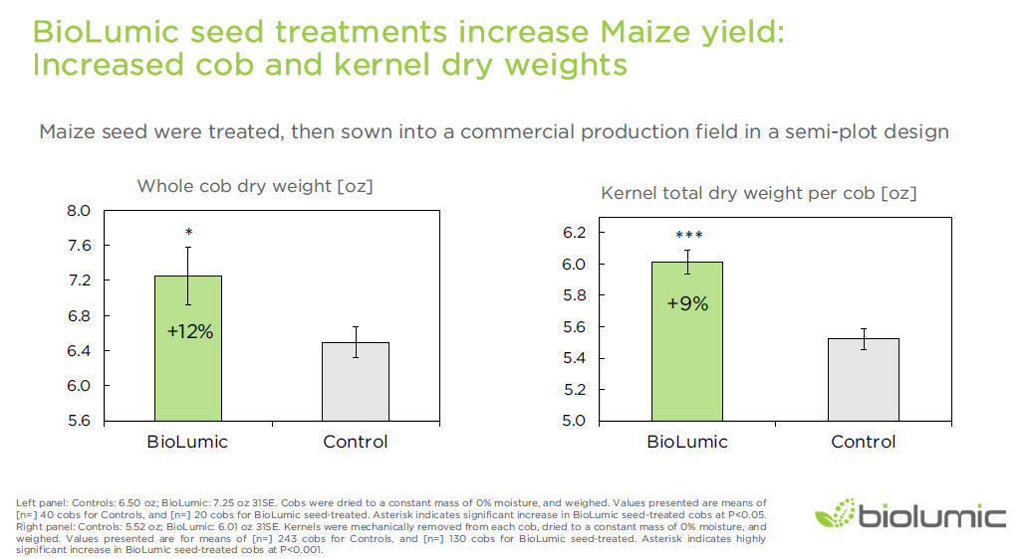
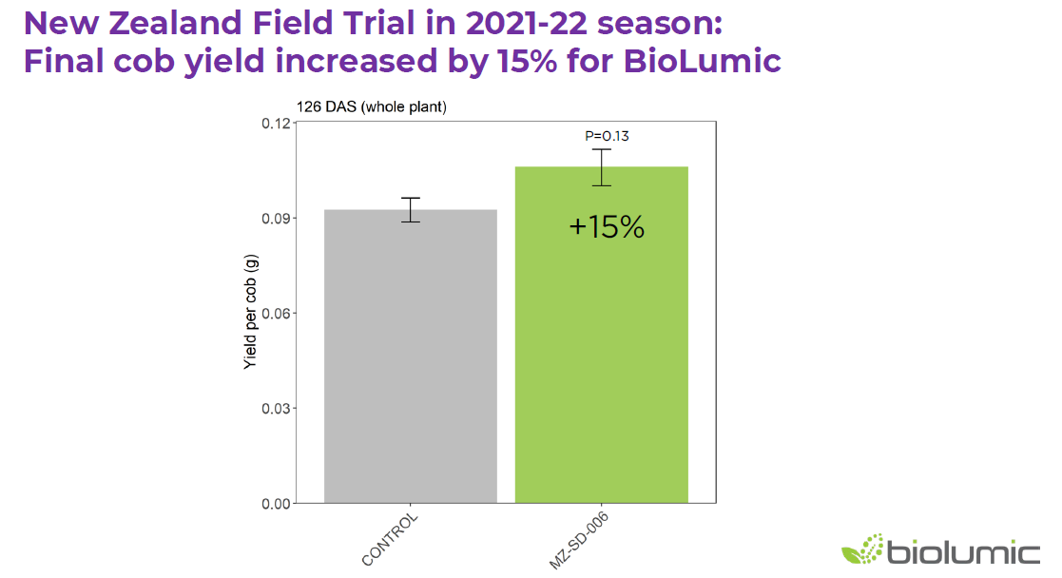
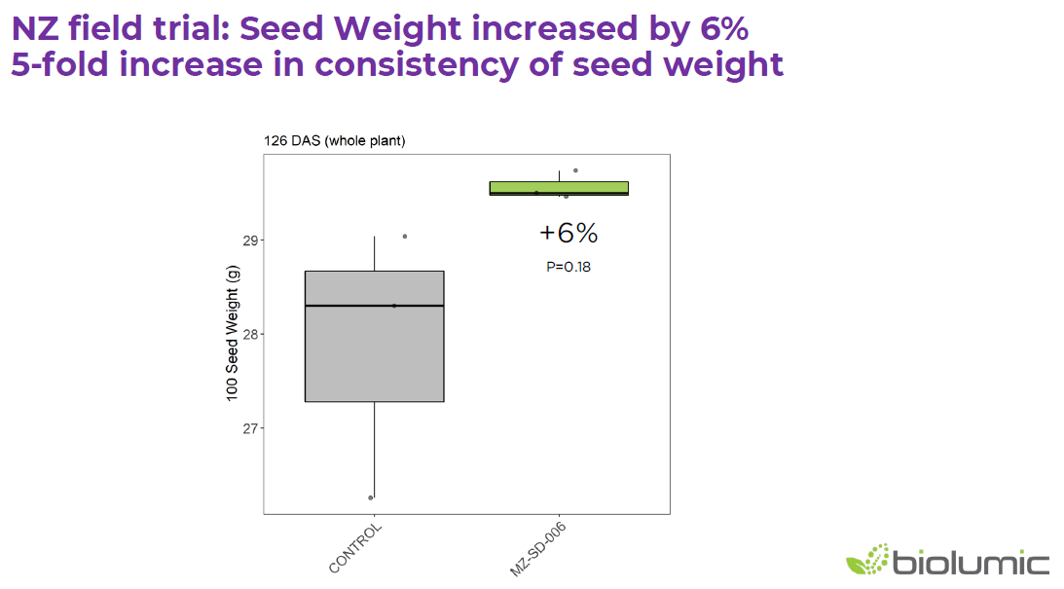
FAR and Biolumic - Maize collaboration
Average 10% increase in maize yield – both silage and grain
Not for all hybrids

Slide 19
Biologicals are here to stay
Consumer demand
Agchem regulations
Climate change
NZ situation
Market size constrains BP development
Market size too small for multinationals
Importing constraints
Regulatory constraints
Cost
Complexity
Marrone BioInnovations
Koppert
BioWorks
Isagro
Stockton
Bayer Crop Science
BASF
Nufarm
Syngenta
DowDupont
Sumitomo

Slide 20
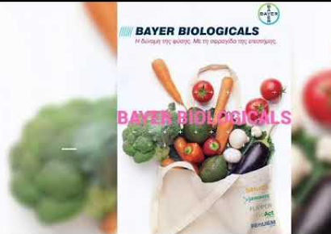
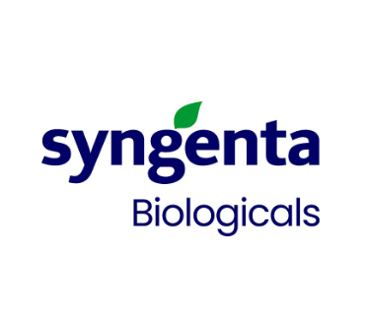
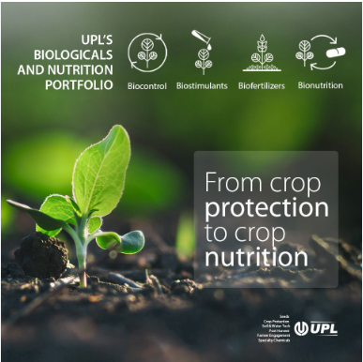

Slide 21
Future Agriculture
Chemically
Intensive
METHOD
“Sustainable” Biologicals + Chemicals (bio-based products as base of the program)
Organic

Slide 22
Thank You

